Slide 1
A quick guide on how to use my reports in EPIC
Conor Foley & Tim Bonnici May 2022

Slide 2
How can you get data? My Reports
Easy to use
Accessible to all
Generates patient lists
Very limited: few parameters you can edit

Slide 3
Use case 1: recent admissions

Slide 4
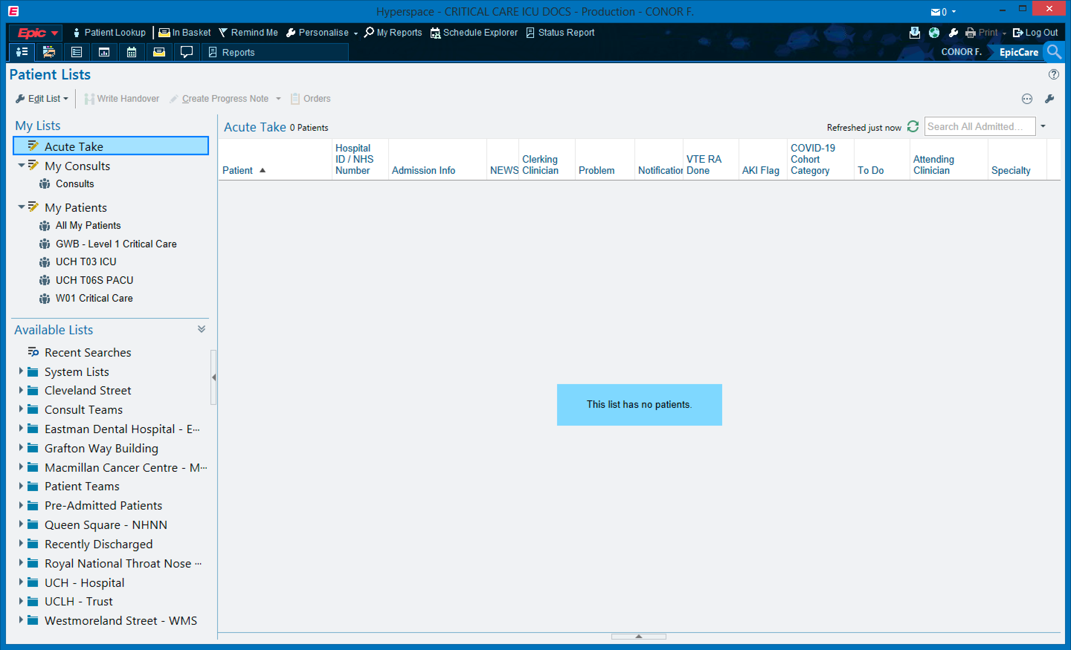

Slide 5
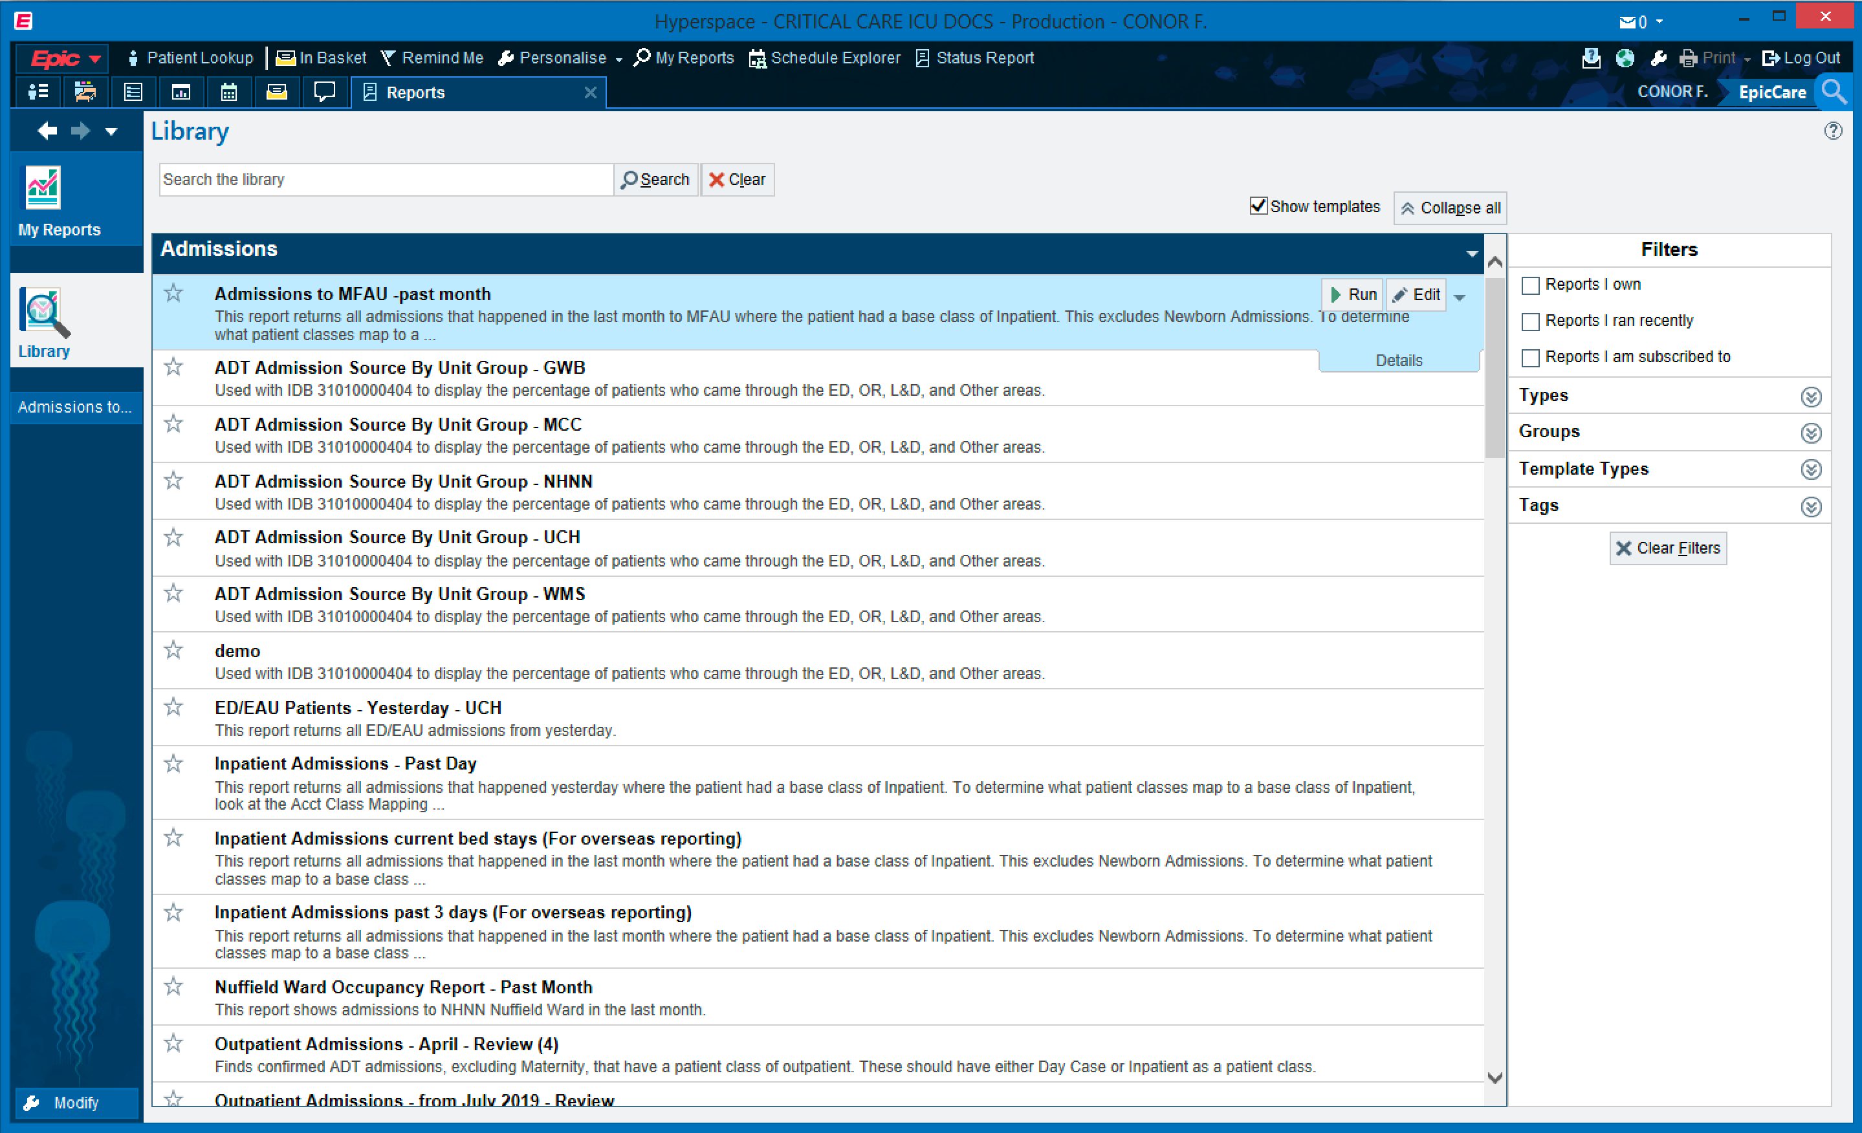

Slide 6
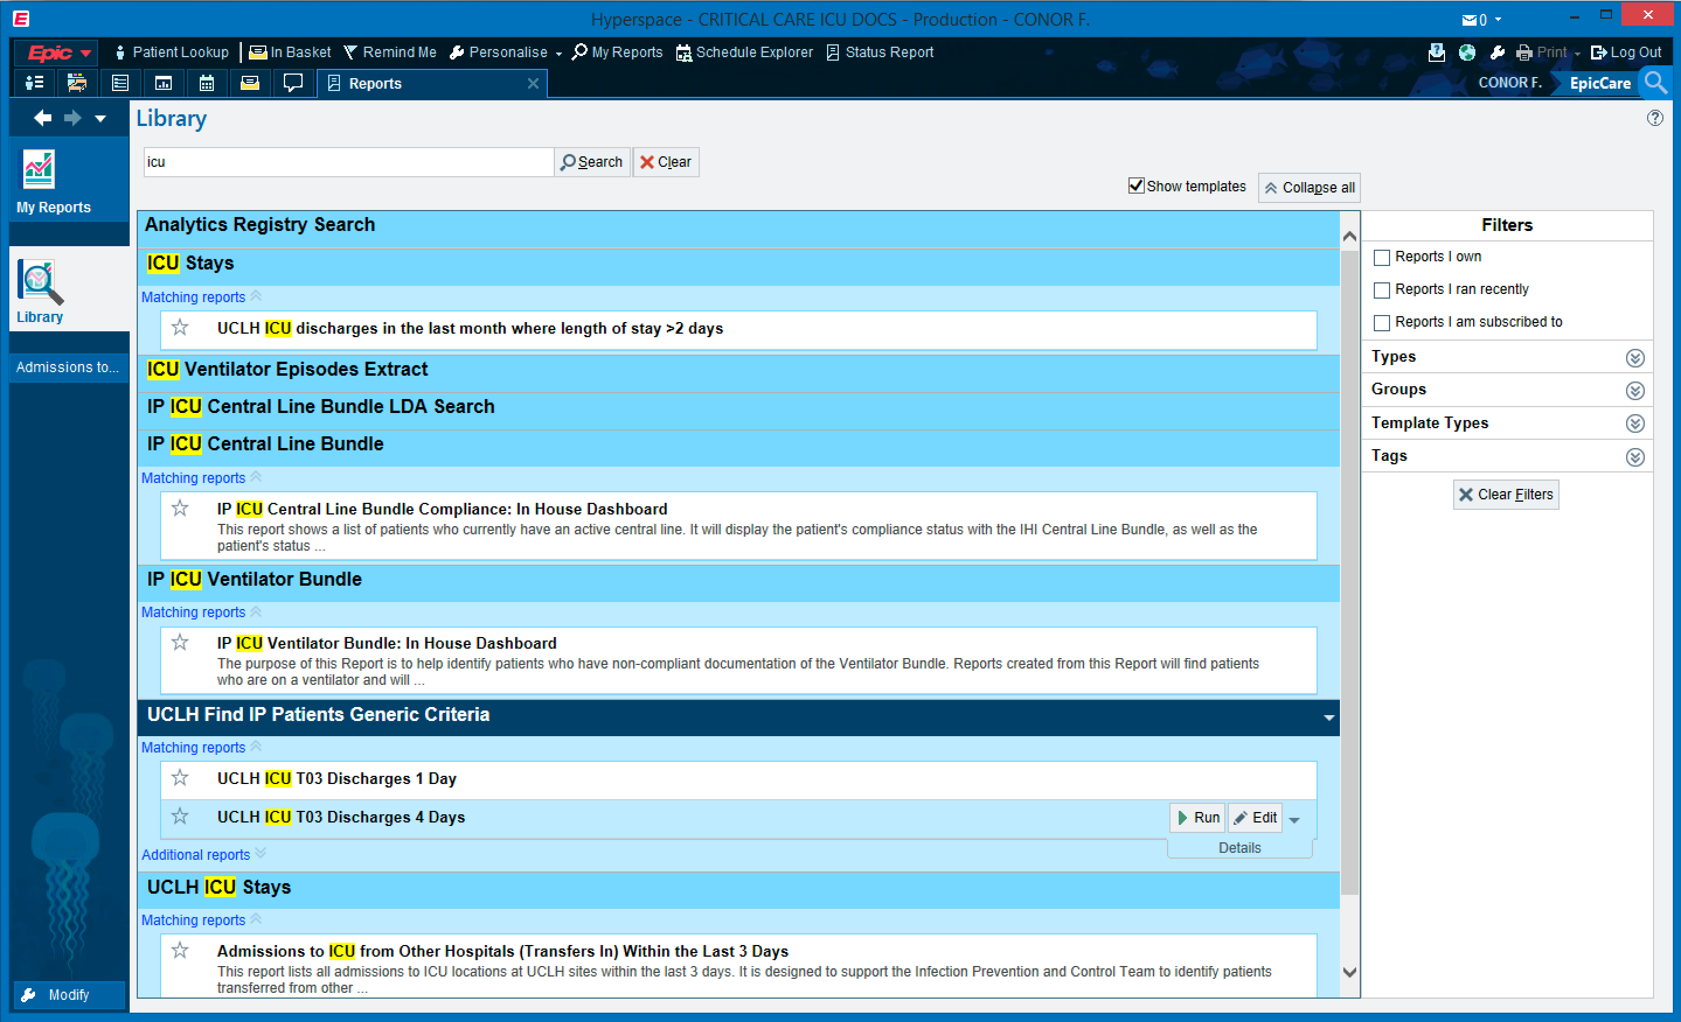
1
2: hover and choose ‘edit’

Slide 7
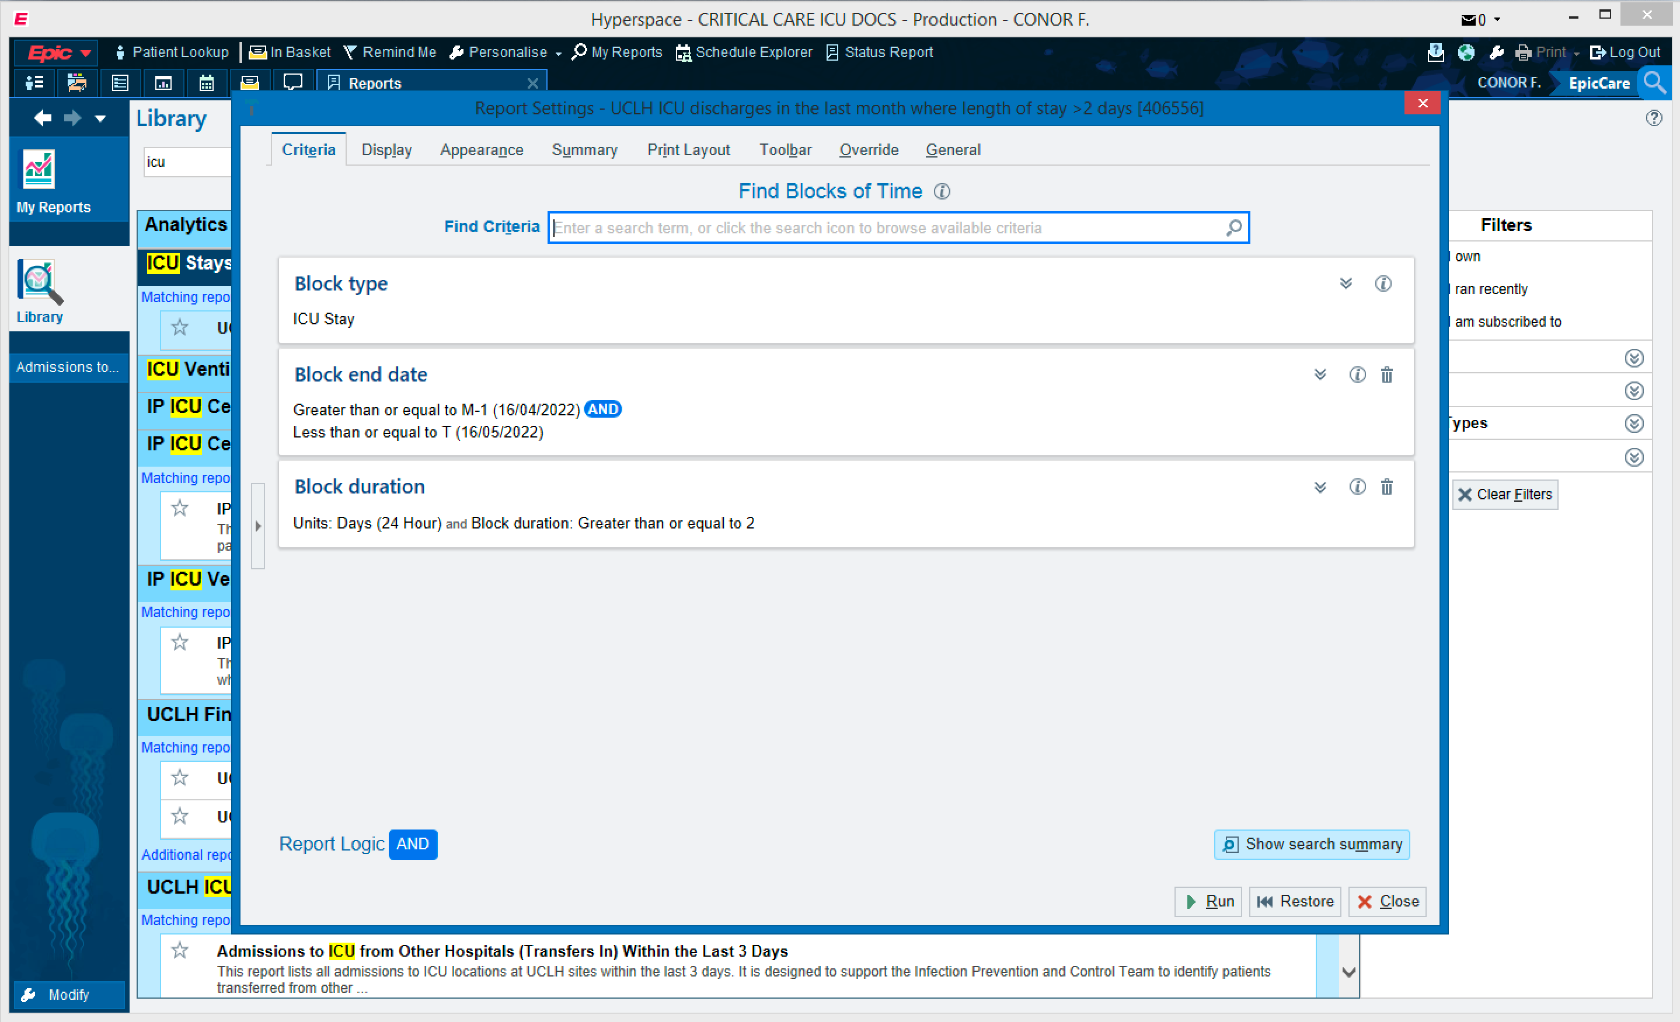

Slide 8
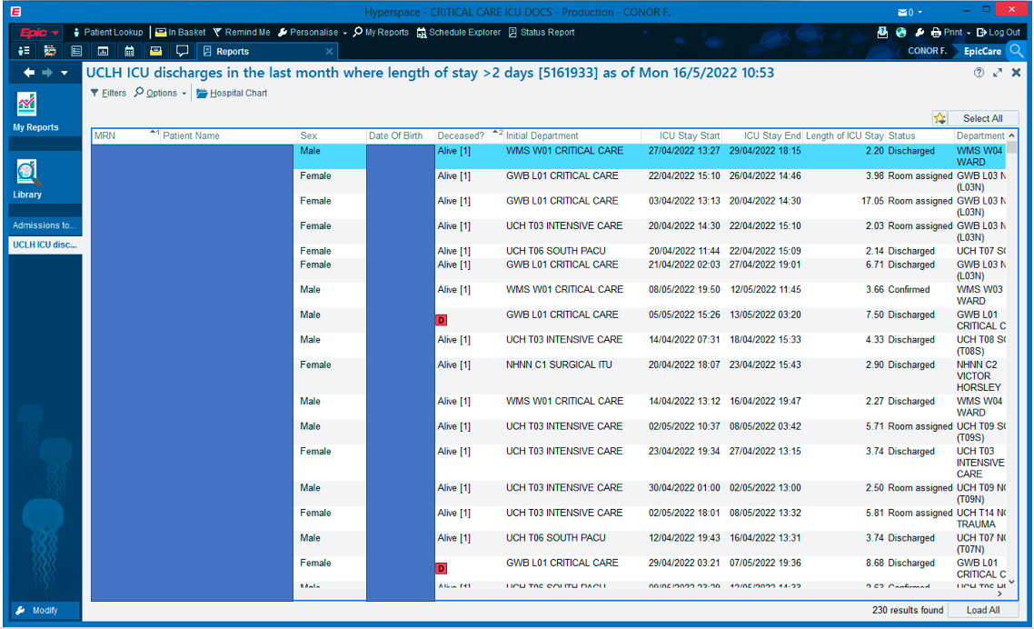

Slide 9
Use case 2: all my procedures

Slide 11
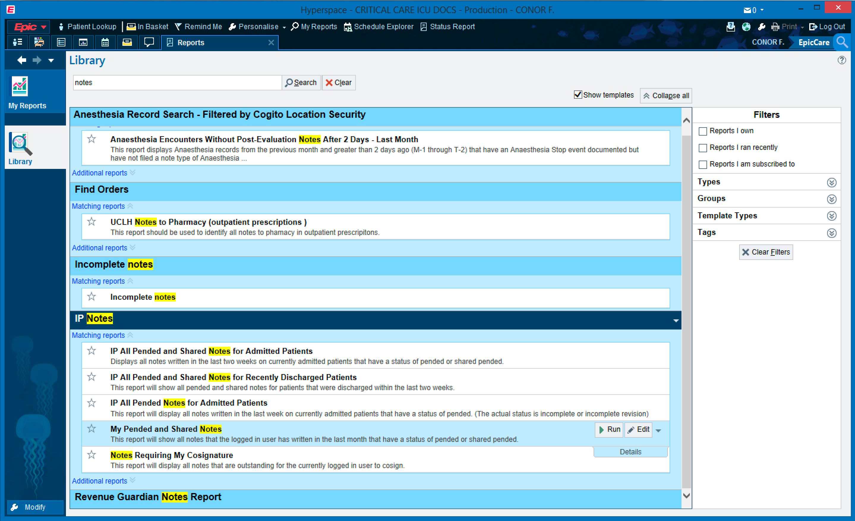
1
2

Slide 12
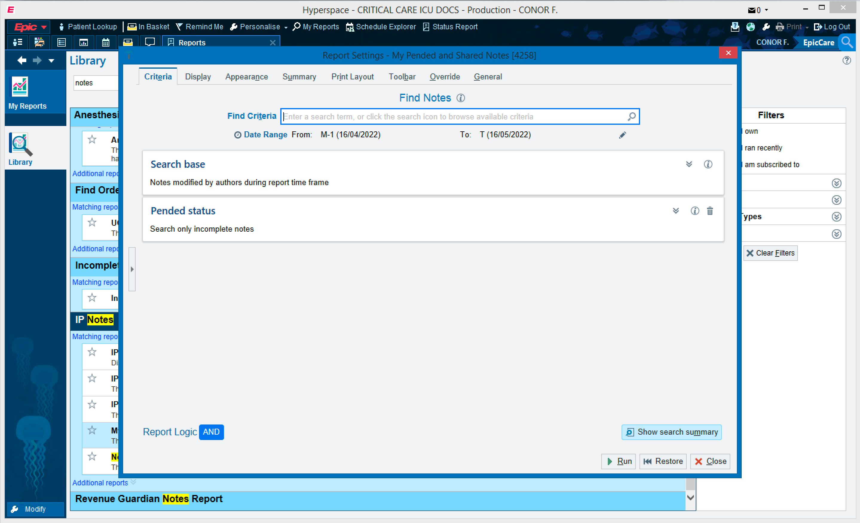

Slide 13
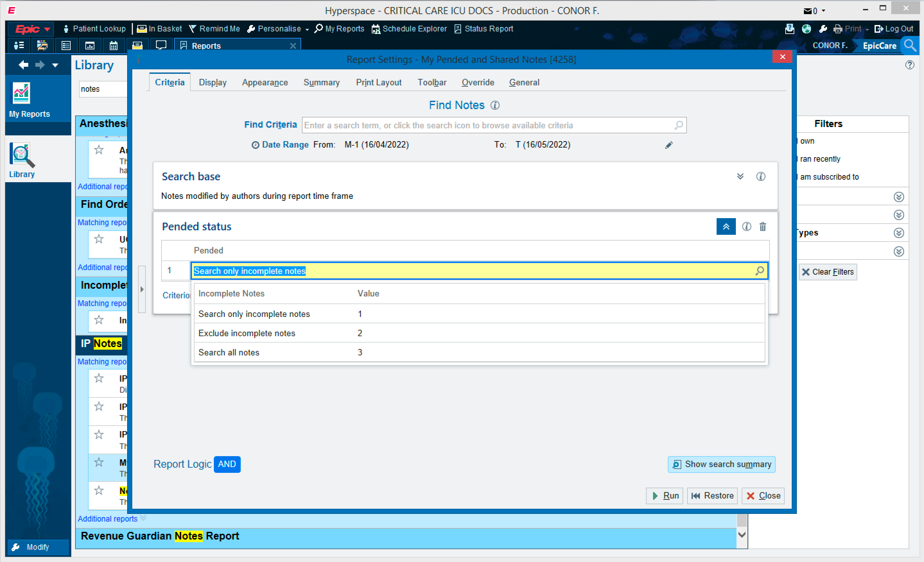

Slide 14

Change time period

Slide 15
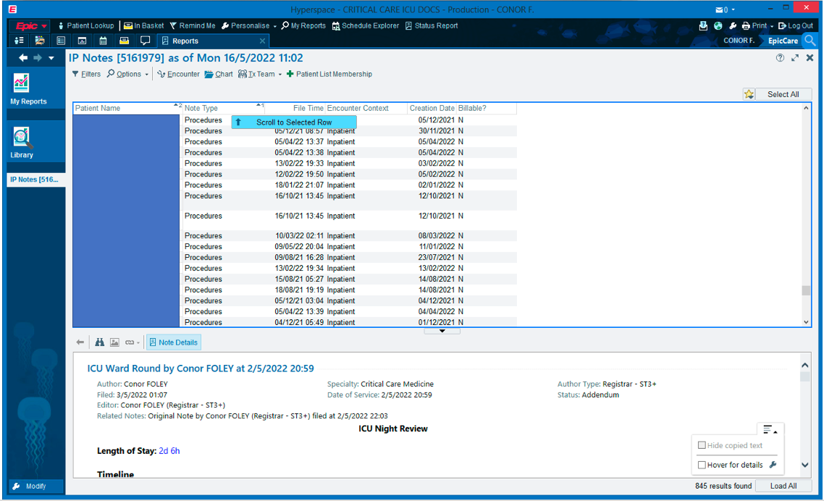
Order by note type

Slide 16
My Reports
With some digging, can answer a reasonable range of questions
Only gives patient lists
Significant data quality issues: cannot look ‘under the hood’
e.g. can list all patients with AKI flag, but does this represent all patients with AKI?
Can save lists, but not download as spreadsheets
Specialised reports can be written and saved to allow re-audit
Needs support from BI team

